Slide 1
How to Get Organized
CHS Guidance Lesson

Slide 2
Overview
What is organization
Why is organization important
Making a Plan
Goal Setting

Slide 3
What is Organization?
The act of putting things into a logical order or the act of taking an efficient and orderly approach to tasks

Slide 4
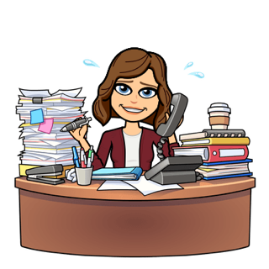
Why is organization important?
Helps to:
- Improves grades
- Reduce Stress
- Boost Self Esteem

Slide 5
How to Start?
Use your planner
Keep your materials organized
Avoid distractions
Everyone will do things differently!

Slide 6
Set your intentions
What do you want to accomplish today?
What are your goals?
Short term
Long term
2 weeks left**

Slide 7
Prioritize
Make a list
Decide what is important
Create a plan
Include things you enjoy into your schedule

Slide 8
Plan Ahead
Know deadlines
Ask your teacher
Use your agenda
Create a schedule
Celebrate small accomplishments

Slide 9
What if you need help?
Teachers
Parents
School Counselor
Friends
Classmates

Slide 10
You got this!

